Slide 1
CNN-generated images are surprisingly easy to spot... for now
Sheng-Yu Wang Oliver Wang Richard Zhang Andrew Owens Alexei Efros
Bingzhao Shan Songlin Liu Zihan Wang

Slide 2
1. Background 2. Introduction
3. ForenSynths Dataset 4. Detecting synthesized images 5. Results & Observations
6. Demo

Slide 3
Background

Slide 4
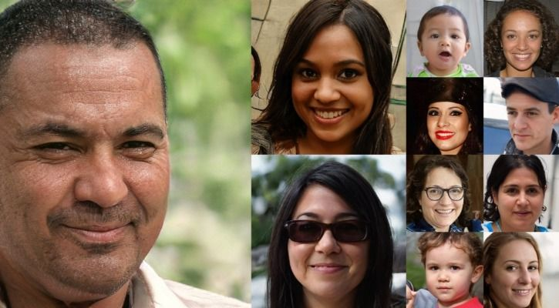
Image Synthesis
Fake images are synthesized via Convolutional Neural Networks (CNNS)
CNN generated fake images can be very realistic
Fake images generated by Generative adversarial network (GAN)

Slide 5
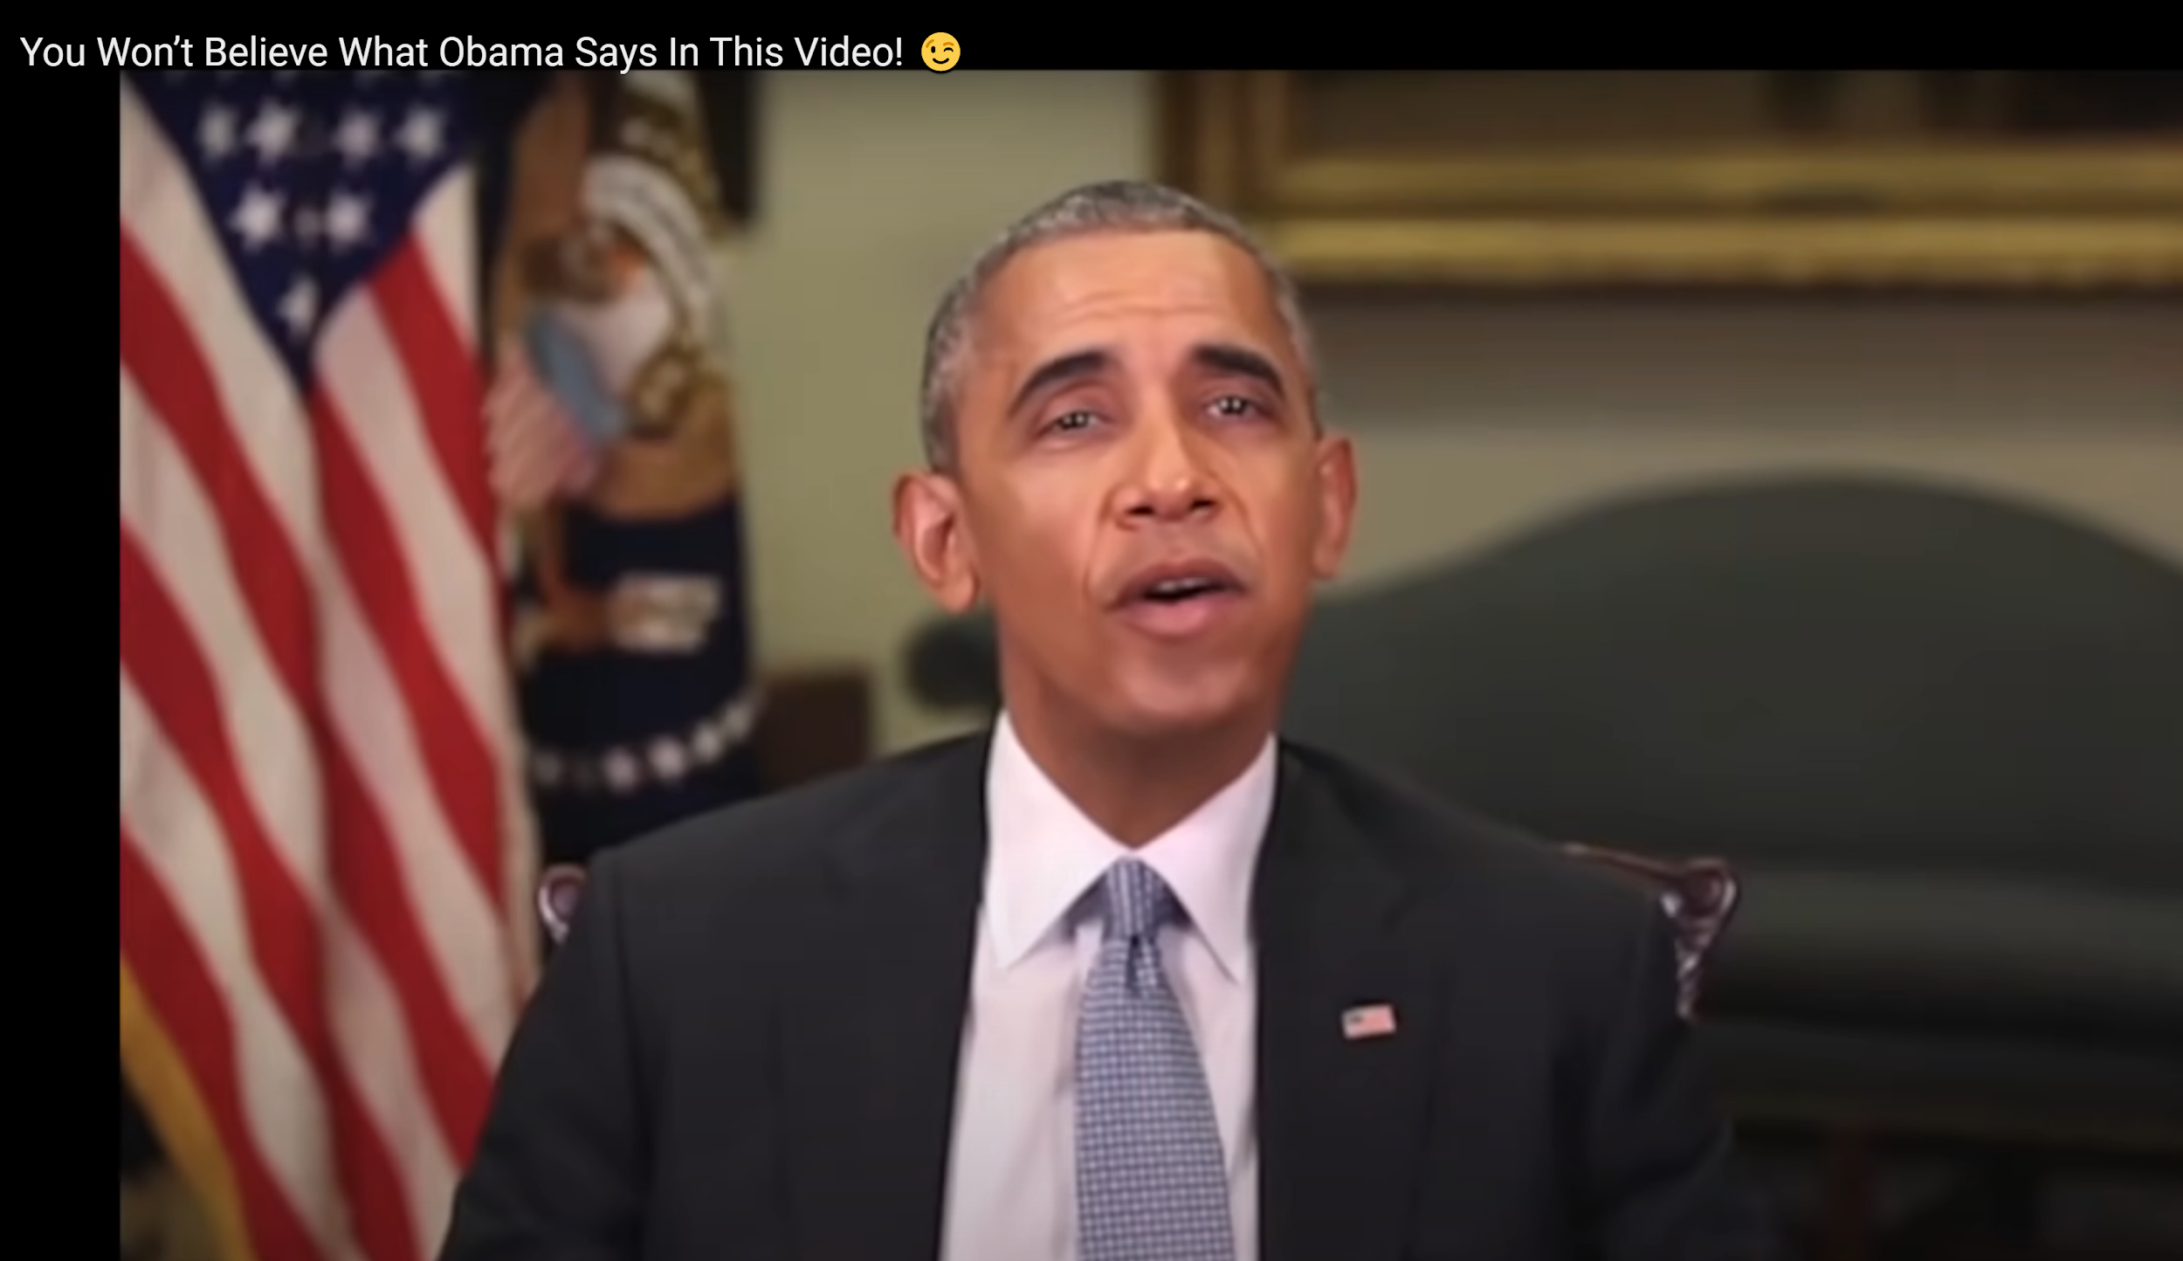
You won’t believe what Obama says in this video!

Slide 6
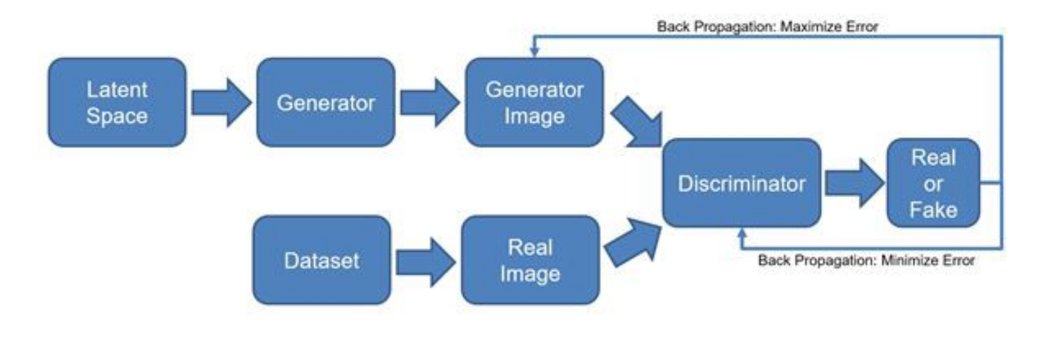
Image Synthesis Techniques-GAN
Generative Adversarial Network (GAN) architecture:
Generator(G) produces plausible fake images given random noise
Discriminator(D) is classifier that distinguish G’s fake images from real images
Goal: G’s outputs are indistinguishable from the real images

Slide 7
Difficulties in Detection of Synthesis Images
Technique-specific-detector detects whether or not an image is synthesis by a specific techniques.
Issues: It is tied to the dataset and likely to soon become ineffective as the generation
methods evolve and the technique it was trained on becomes obsolete.
Solution: A generalized detector that can detect fakes on unseen synthesis technique and datasets
Researchers have reported generalization to be a significant problem for image forensics approaches.
Reason: Image synthesis techniques are highly varied:
Datasets
Network architectures
Loss functions
Image pre-processing

Slide 8
Introduction

Slide 9

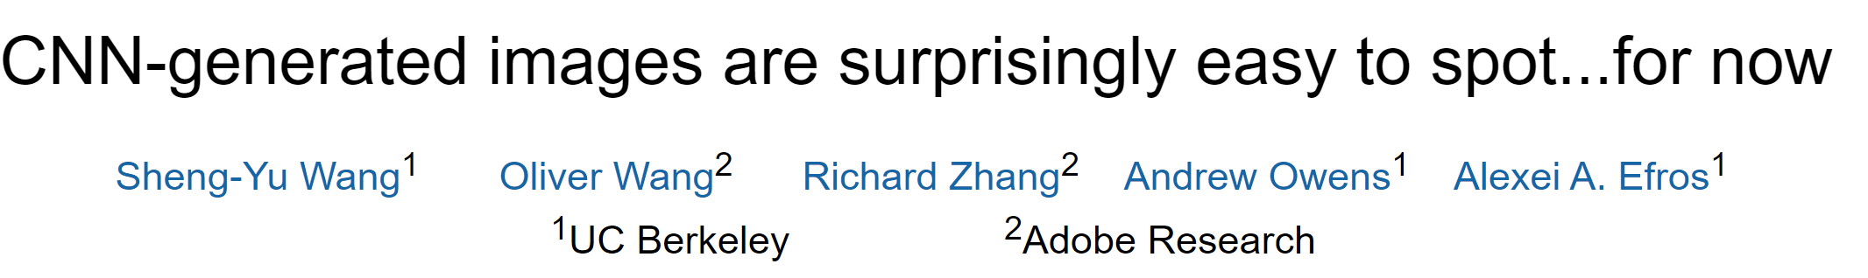

Slide 10
Big Ideas
Find general image forensics approach for detecting CNN-generated imagery.
Are there common features or artifacts shared across diverse CNN generators ?
Is it possible to train a forensics classifier on images from one model that generalize to those of many models (cross-model generalization)?
Does the trained classifier perform well across different datasets ?

Slide 11
Main Contributions
Showed that forensics models trained on CNN-generated images exhibit a surprising amount of generalization to other unseen CNN synthesis methods.
Proposed a new dataset and evaluation metric for detecting of CNN-generated images.
Experimentally analyzed the factors that account for cross-model generalization.

Slide 12
Related Work

Slide 13
Related Work – Detect CNN Based Manipulation
Rössler et al. showed that simple classifiers could detect fakes generated by a specific face manipulation model.
Zhang et al. found that classifiers generalize poorly between GAN models and proposed AutoGAN for generating images that contain the upsampling artifacts common in GAN architectures.
Cozzolino et al. proposed an autoencoder based new learning method to improve the transfer performance in zero- and low-shot regimes for a variety of generation methods including both CNN and non-CNN based models.

Slide 14
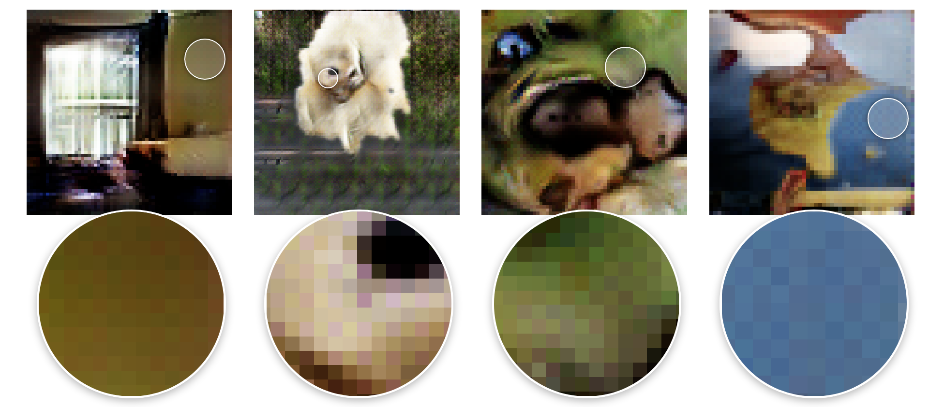
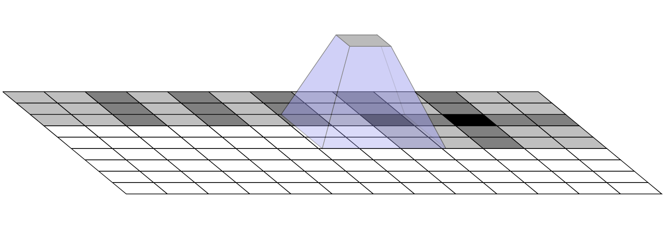
Related Work – Artifacts from CNN-based Generators
Odena et al. reported that deconvolution during upsampling ignores classical sampling theorem and produces checkerboard artifacts that reduce CNN representational power.
Example: checkerboard artifacts
Deconvolution can have overlap

Slide 15
The ForenSynths Dataset

Slide 16
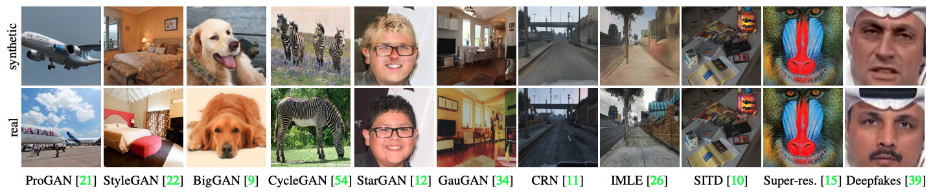
The ForenSynths Dataset
A large dataset of a mixture of real and CNN-generated images
11 synthesis models, span a variety of CNN architecture, datasets, and losses
All these models have an upsampling convolutional structure

Slide 17
The ForenSynths Dataset
A large dataset of a mixture of real and CNN-generated images
11 synthesis models, span a variety of CNN architecture, datasets, and losses
All these models have an up-sampling convolutional structure

Slide 18
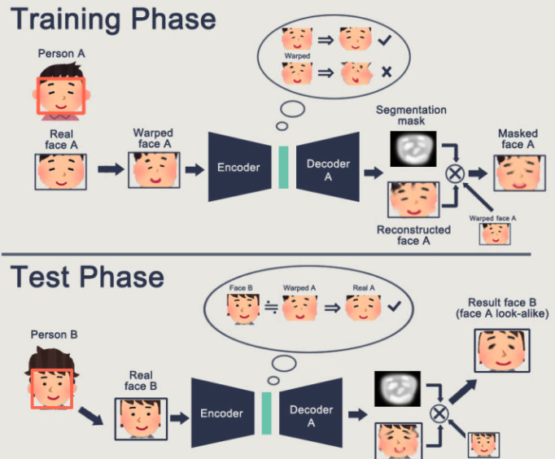
The ForenSynths Dataset
GANs (3 + 3)
Unconditional GANs: ProGAN, StyleGAN, BigGAN(class-conditional)
Conditional GANs: GauGAN, CycleGAN, StarGAN
Perceptual loss (2)
CRN, IMLE
Low-level vision (2)
SITD, SAN
DeepFake* (1) [out-of-distribution test case]
Poisson image blending

Slide 19
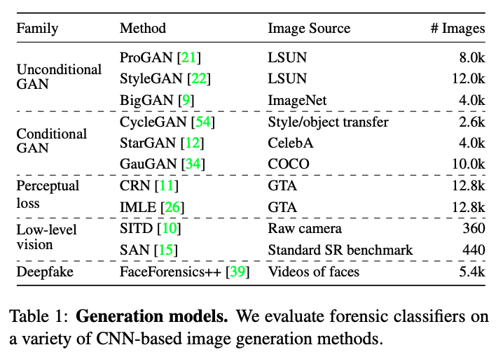
The ForenSynths Dataset

Slide 20
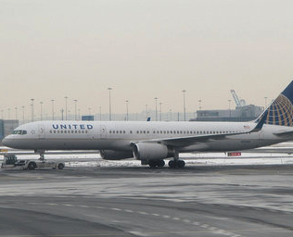
The ForenSynths Dataset
Image size: 256x256
For models that generate images at lower resolutions, resize their output images using bilinear re-scaling.
For models that generate images at higher resolutions, keep the images at that resolution.
Training/Testing:
Random crop at training time, 224x224
Center-crop at testing time, 224x224

Slide 21
Detecting CNN-synthesized images

Slide 22
Detecting CNN-synthesized images
Are there common features or artifacts shared across diverse CNN generators?
To understand this, the authors studied whether it is possible to train a forensics classifier on images from one model that generalize to those of many models.
Why one model is used?
Using one model is the upper bound of how challenging the task is — jointly training on multiple models would make the generalization problem easier.
Images generated by ProGAN are used as the training dataset.
High image quality
Simple convolutional network structure

Slide 23
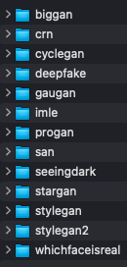
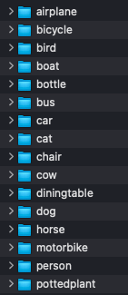
Detecting CNN-synthesized images
5 copies
No Augmentation
20 different ProGANs are used
Gaussian Blur
JPEG
Blur + JPEG(0.5)
Blur + JPEG(0.1)
ForenSynths Dataset
Real/Fake

Slide 24
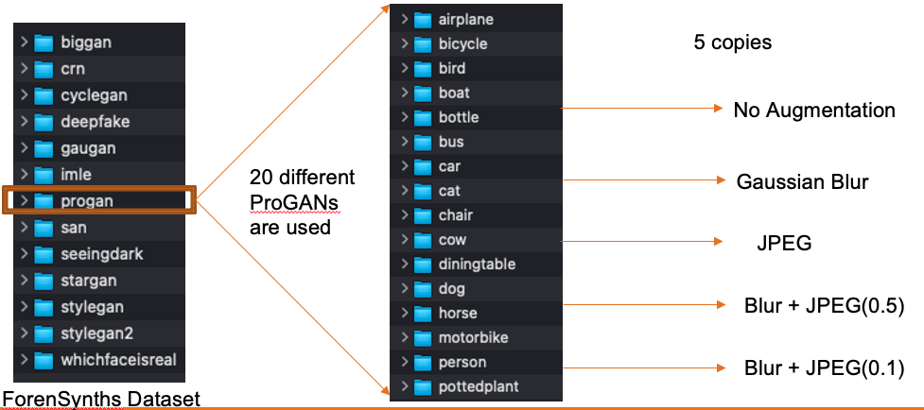
Detecting CNN-synthesized images
Crop -> 224x224
ResNet-50 classifier pre-trained with imagenet. Model1
Real or Fake
ResNet-50 classifier pre-trained with imagenet. Model5
Real or Fake

Slide 25
Results & Observations

Slide 26
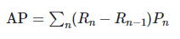
Metric for Evaluation: AP
Definition from Sci-kit Learn
*n represents the n-th threshold
AP can be understood as weighted average of all precision scores across different threshold

Slide 27
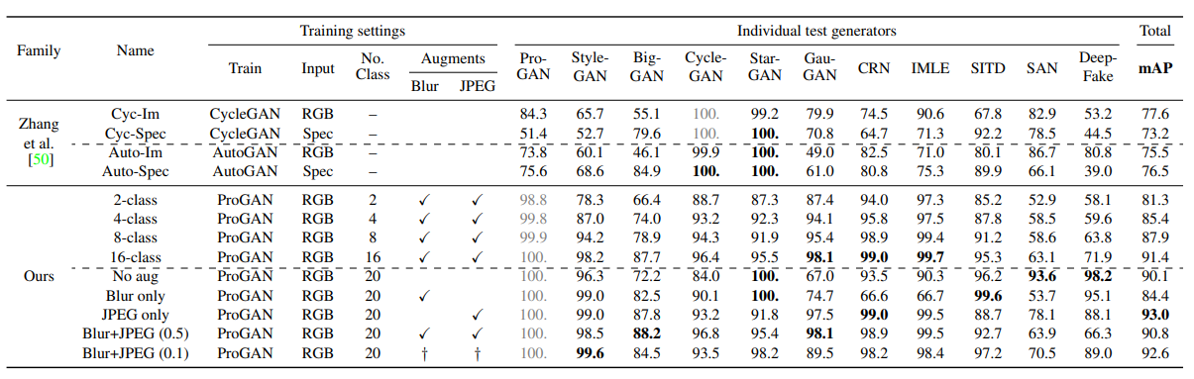
Effect of Different Augmentation Patterns
50%
Mean AP of across all datasets
10%
Conditional GANs
Notes:
a

Slide 28
Effect of Different Augmentation Patterns

Slide 29
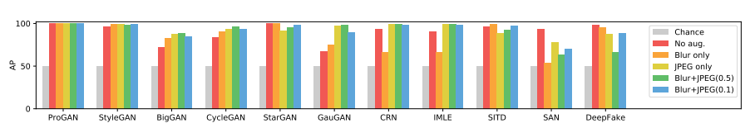
Augmentation Improves Generalization (generally)
Chance == random guesses, which will always have 50% AP (half of your guess is correct)
Good generalization to StyleGAN without augmentations (similar structure)
Improved generalization from red to green on almost all GANs (except StarGAN)
Drastic drop in generalization for SAN and DeepFake

Slide 30
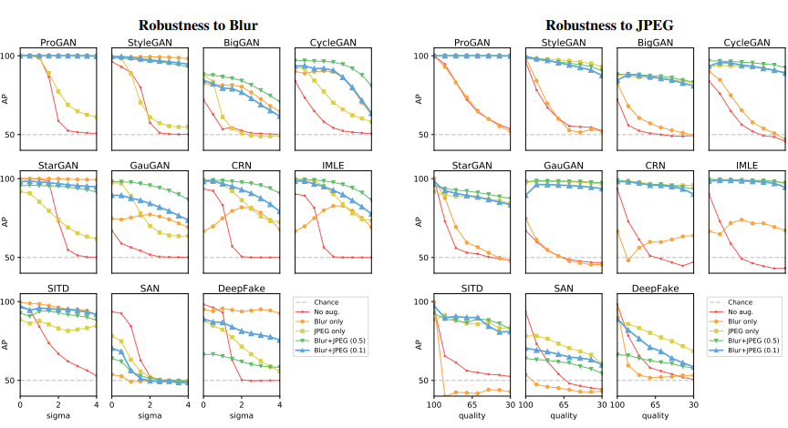
Augmentation improves Robustness

Slide 31
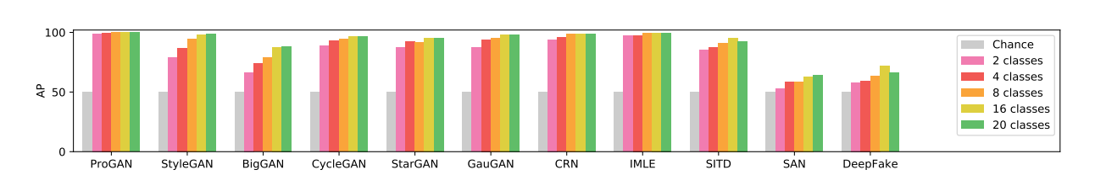
Dataset (class) Diversity Improves Performance
Increased AP when class diversity increases
Diminishing return, minimum increment from 16 classes to 20
There might be sweet spots of class diversity for given datasets which means “diverse enough”

Slide 32
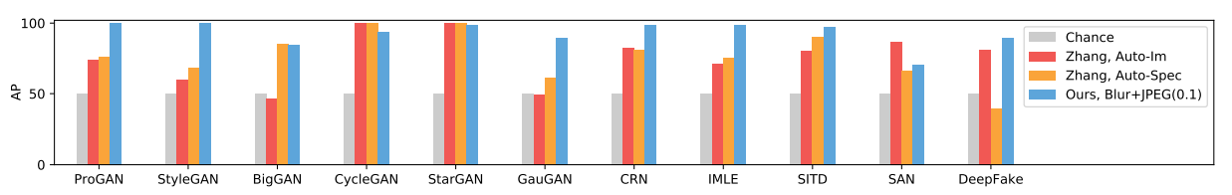
Comparison to other classifiers
Key differences:
AutoGAN and CycleGAN instead of ProGAN to generate training set
Input mode can be spectrum
The method proposed by the authors out performed the comparison models except cycleGAN and starGAN (also SAN, but the paper didn’t mention)

Slide 33
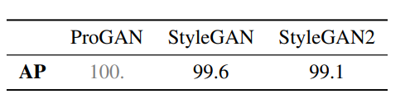
Generalizes to Newer Architectures
StyleGAN2 makes improvement over StyleGAN
10% Blur + 10% JPEG Augmentation

Slide 34
Interpreting the Classification Power
To understand what knowledge the model uses to distinguish between real and fake:
Rank test instances from 0% confidence to 100%
Question:
What does the model see?
Low level feature (fine-grained)?
Semantic level feature?

Slide 35
Interpreting the Classification Power
Answer:
Most datasets does not display semantic level feature differences, so the authors conclude that the model might be looking at low-level CNN artifacts, such as those caused by upsampling
Exception:
StarGAN and BigGAN datasets

Slide 36
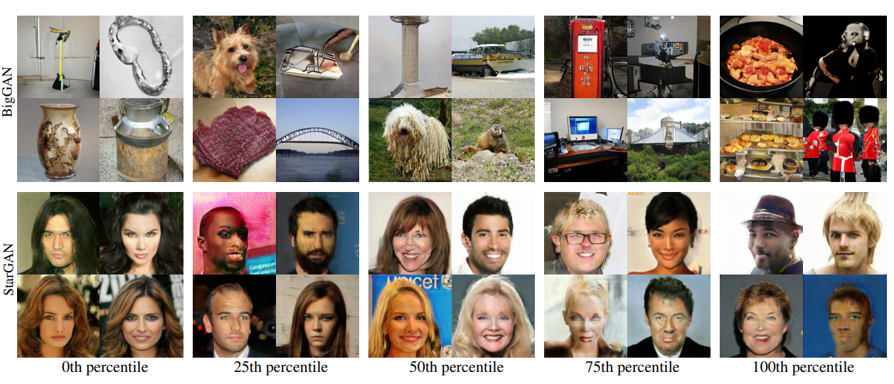
StarGAN & BigGAN Example Ranking
Left to right => real to fake

Slide 37
Frequency Analysis of Reals and Fakes
Apply high pass filter (subtract median blur)
Average across 2000 examples (less if there is not enough images in that dataset)
Calculate Fourier transform of each image

Slide 38
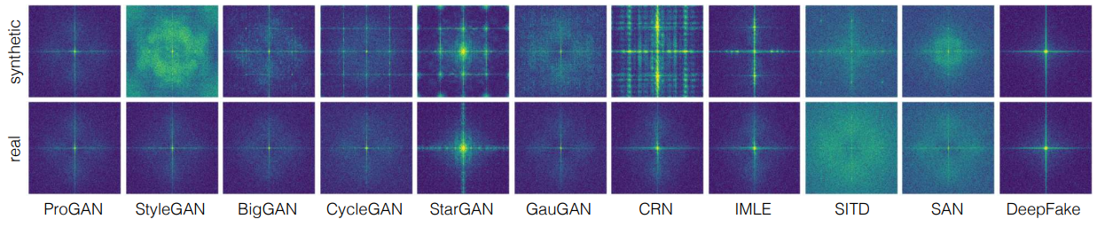
Frequency Analysis of Reals and Fakes
Observations:
Most advanced GANs (ProGAN, BigGAN) has less visible artifacts
DeepFake which uses various pre/post processing, artifacts does not emerge

Slide 39
Appendix

Slide 40
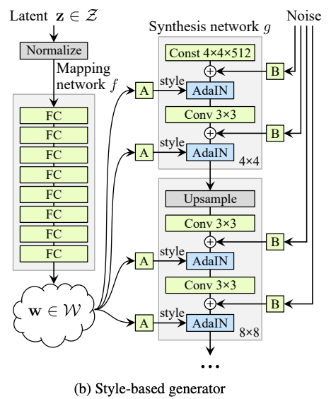
StyleGAN

Slide 41
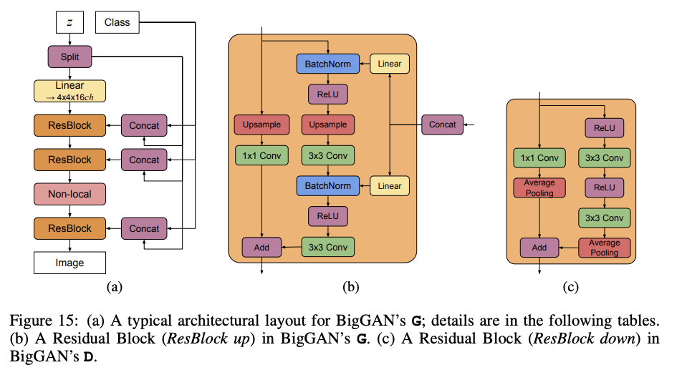
BigGAN

Slide 42
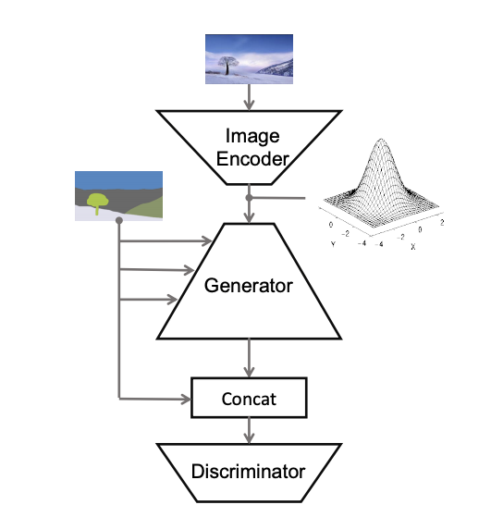
GauGAN

Slide 43
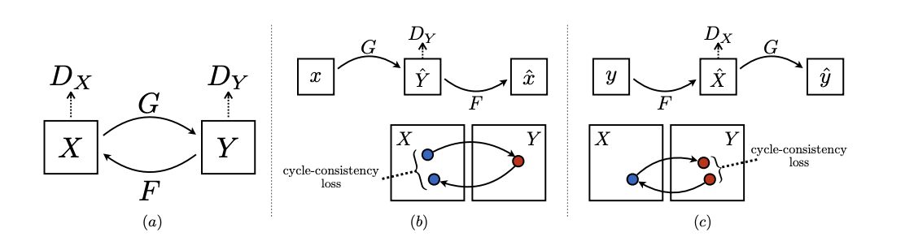
CycleGAN

Slide 44
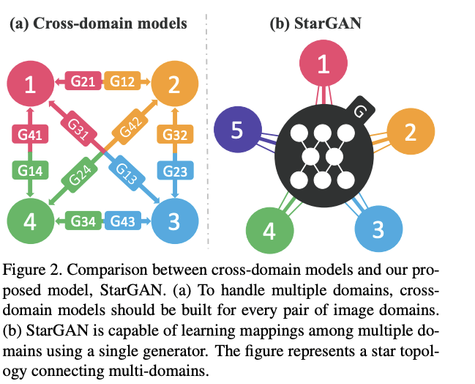
StarGAN

Slide 45
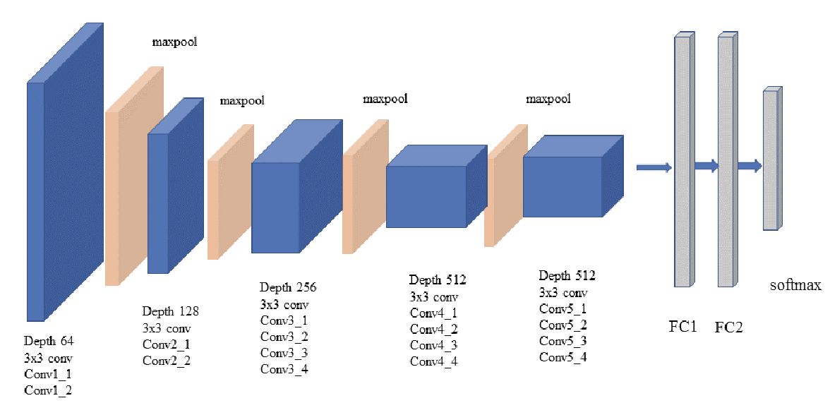
Perceptual losses
https://arxiv.org/pdf/1603.08155.pdf

Slide 46
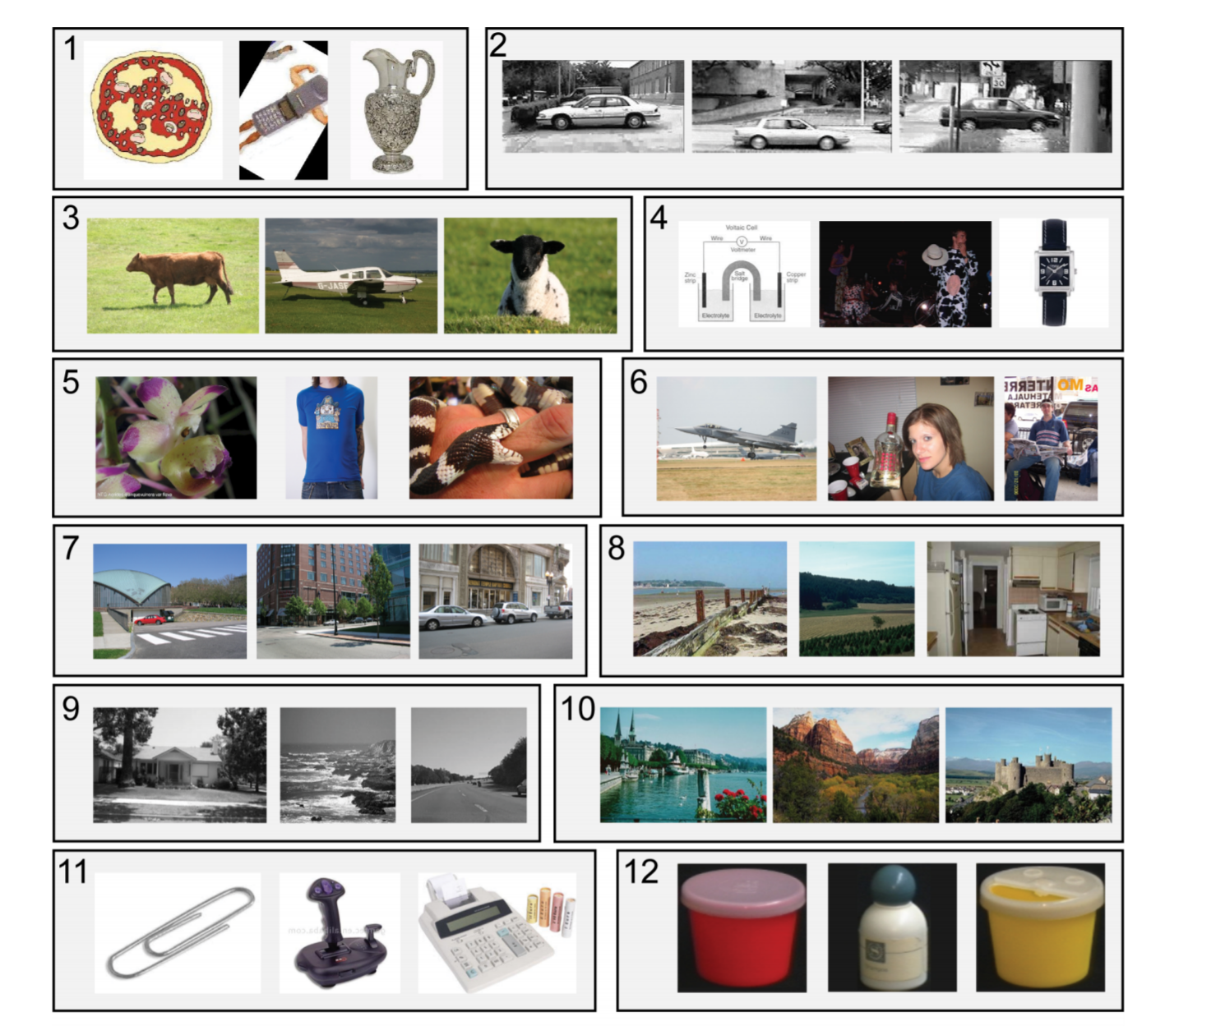
Datasets are biased
Datasets often started out as data capture efforts aimed at representing the visual world, have become closed worlds unto themselves.
Answer key:
1) Caltech-101, 2) UIUC, 3) MSRC,
4) Tiny Images, 5) ImageNet, 6) PASCAL VOC,
7) LabelMe, 8) SUNS-09, 9) 15 Scenes,
10) Corel, 11) Caltech-256, 12) COIL-100.
Notes:
So why haven’t there be a detector for CNN generated images? Here are some obstacles:

